Slide 1
Job Searching Portal
Find Your Dream Job with Us

Slide 2
OBJECTIVE:
Building a user-friendly job search portal with React, featuring smooth interfaces for Seekers and Employers. Enables quick, interactive job listings, applications, and dashboards.

Slide 3
PROBLEM STATEMENT:
Job seekers and employers often struggle with complicated job search websites that are hard to use. These platforms might not meet the specific needs of each user, causing frustration and making job searching and hiring less efficient. We need a simple, easy-to-use, and responsive interface that caters to both Seekers and Employers, with straightforward access to job listings, application forms, and dashboards. Using React will help make the site fast and interactive, improving the overall user experience.

Slide 4
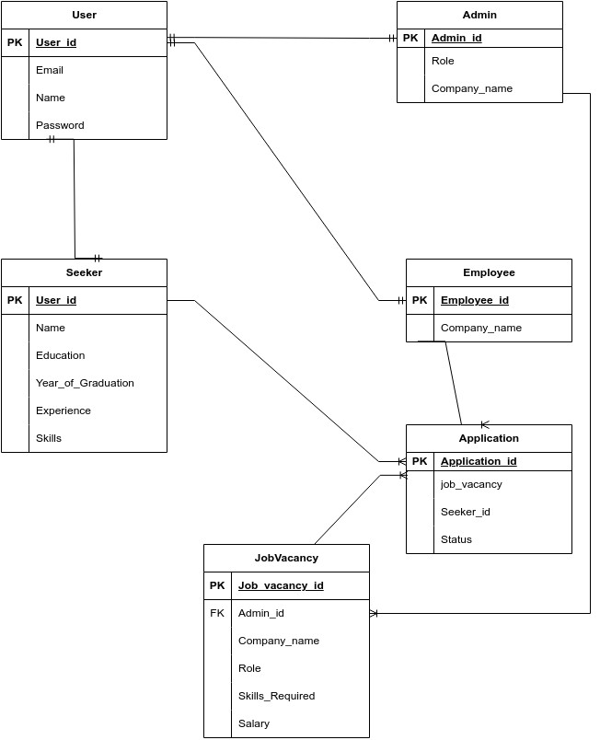
ENTITY RELATIONSHIP-DIAGRAM

Slide 5
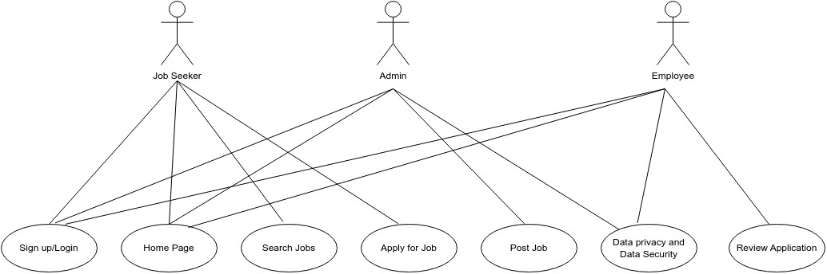
USE CASE-DIAGRAM

